Slide 1


What are they?
Can they be made?
By Alexander Wood

Slide 2



Agenda
Optimise movie making
Synergise with actionable features
Develop profit
Energize neuron activity

Slide 3





Introduction
You, our valued customers at , have recently opened a new movie division.
With our expert team consisting of a data analyst, we will provide you with the mathematically perfect recipe for your flagship movie

Slide 4
Summary
Data analysis
Three Categories of success
Data has been taken from IMDB and Box Office Mojo to determine the three categories that determine the success of a movie
Genre
Game Show
Director
Quentin Tarantino
Movie length
As long as humanly possible
Or 120 minutes if you want to be a coward optimal

Slide 5

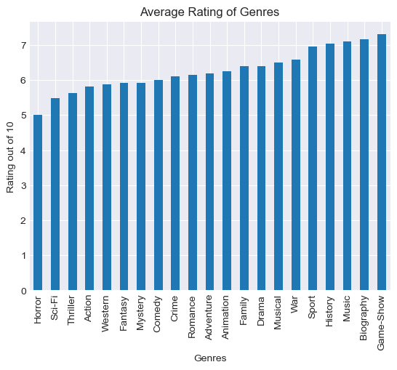

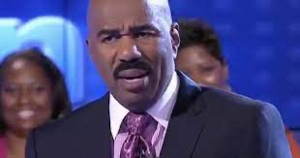
Category
𝒢𝑒𝓃𝓇𝑒

Slide 6
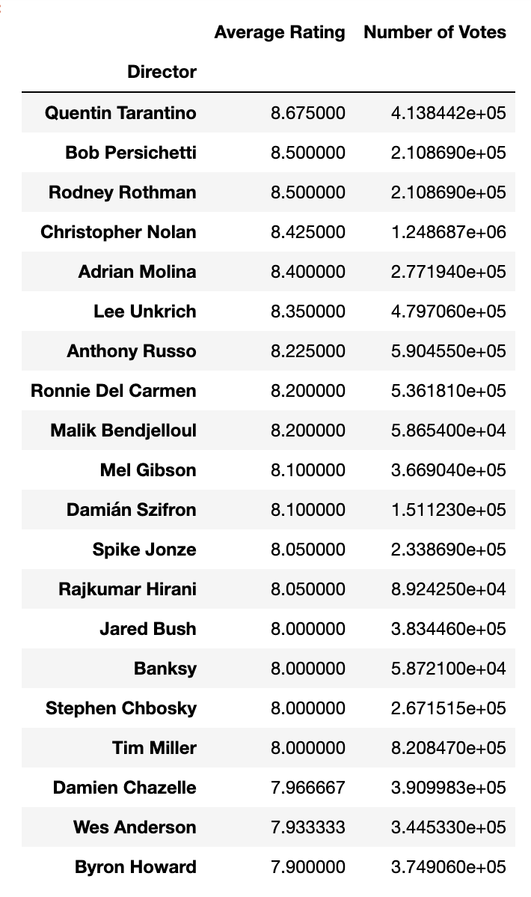
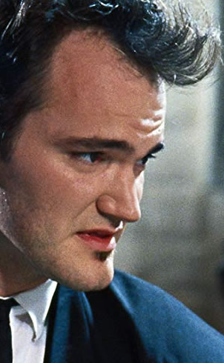

Topic 2
Director

Slide 7

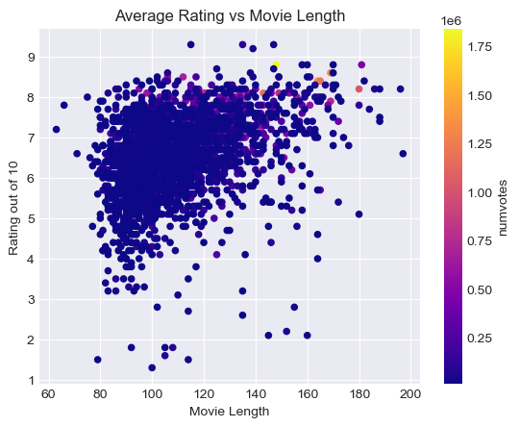

CATEGORY
Length of Movie

Slide 8
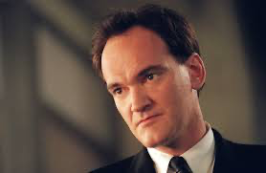
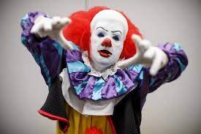
Conclusions
Hire:
Quentin Tarantino
Make:
Game Shows
Length:
120 Minutes

Slide 9


Thank
You

